Slide 1
Object Capture
작성자 : 김은규

Slide 2
목차
01. Change Log
02. AR Companion
03. Object Capture

Slide 3
01. Change Log
v0.1 : 2022.03.24 Object Capure 초안 작성

Slide 4
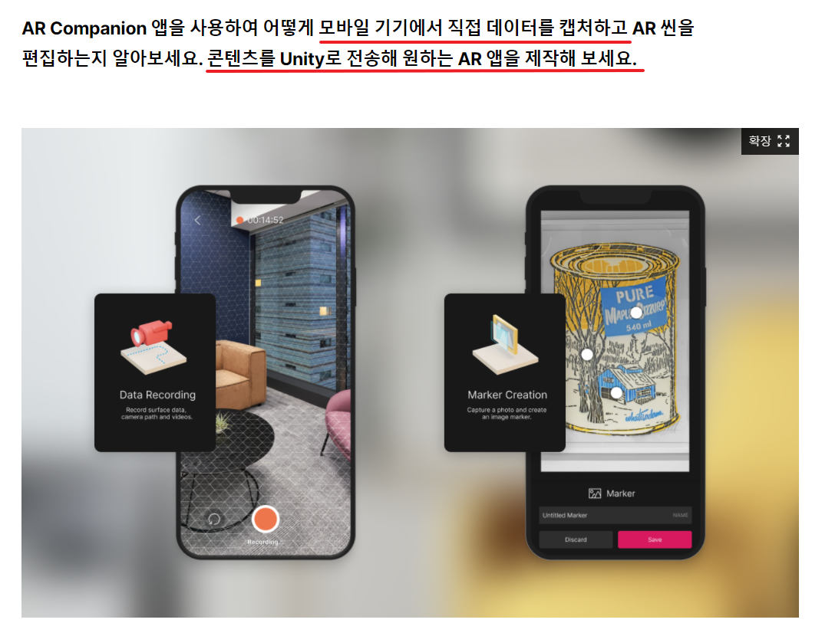
02. AR Companion

Slide 5
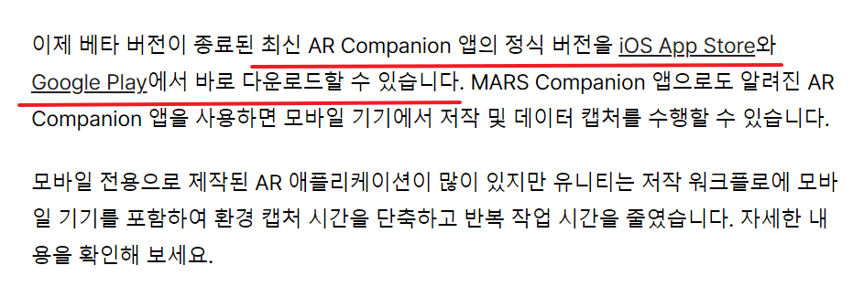
02. AR Companion

Slide 6
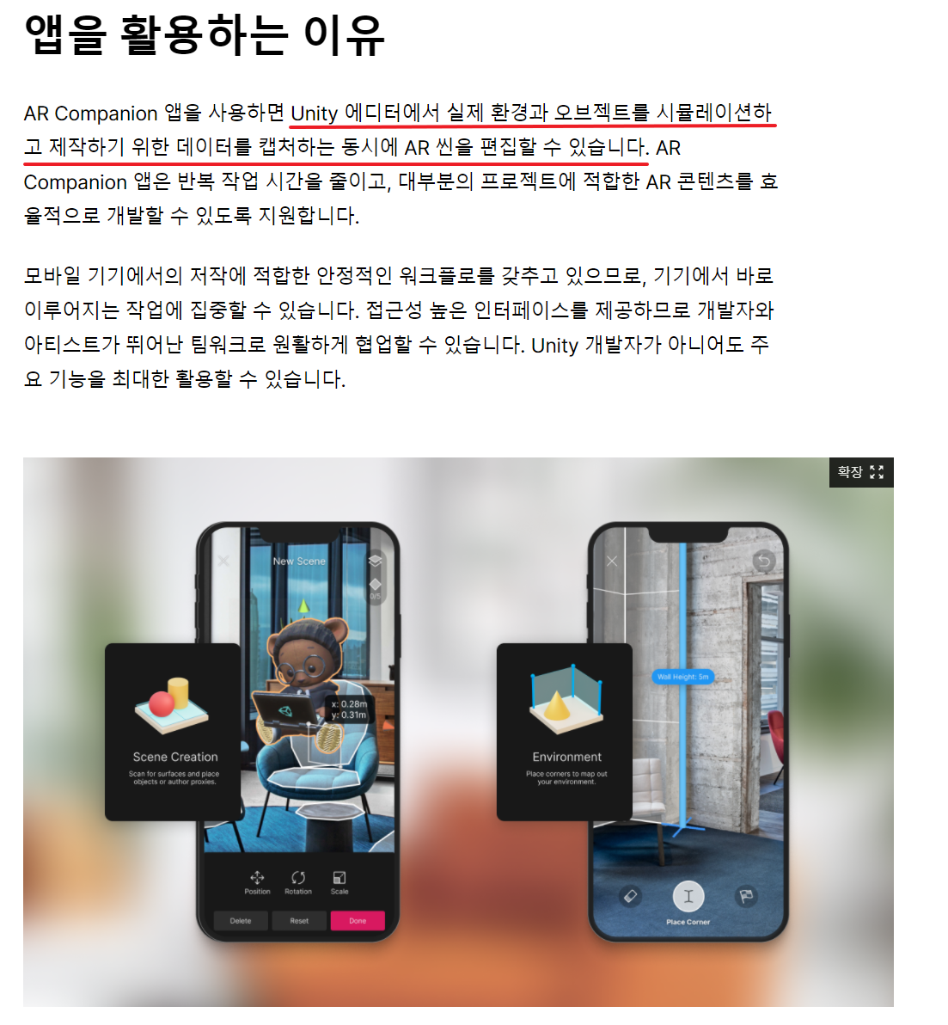
02. AR Companion

